Slide 1
What are we trying to solve?

Slide 2
Pizza on the Go by Torqata

Slide 3
Tire’d of regular pizza delivery?
Why not give us a spin . . . .

Slide 4
How are we going to solve this?
Transactional Ingestion System:
Utilize existing API servers.
Potentially “bursty” traffic that could cause issues for a traditional n-tier solution.
Must maintain transactional data permanently in a cost- effective manner.
Scale as needed based orders to maintain 15 minute SLO.
Customer Database:
Utilize traditional RDBMS system.
Customer list will remain constant over time.
Adult Population Dataset:
Curate a dataset that provides adult population by state.
Create a reporting datamart:
End user should be able to query by state several key dimensions to reflect sales effectiveness.
Data must be refreshed at least once a day (more often is better).
Keep the data in the datamart as small as possible to speed performance and reduce cost.

Slide 5
My approach and Why GCP?
Torqata currently utilizes GCP so a focus on GCP will limit the amount of staff retraing and allow the teams to hit the ground running.
Google builds managed solutions based on open source technologies. Migration to another provider would be possible to “lift and shift” to equivalent technologies. BigQuery to Hive, Pub/Sub to Kafka and GKE to Kubernetes. This reduces rework and tech debt
Deploy managed services where possible. Built-in monitoring, HA and backups reduce maintenance costs and increase reliability.

Slide 6
Transactional Ingestion System
Utilize existing API servers.
Potentially “bursty” traffic that could cause issues for a traditional n-tier solution.
Must maintain transactional data permanently in a cost- effective manner.
Scale as needed based orders to maintain 15 minute SLO.

Slide 7
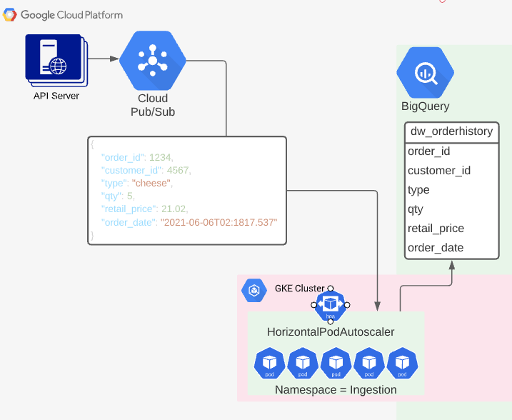
Transactional Ingestion System explained
API server produces data to Pub/Sub. Ingestion microservices consume Pub/Sub topics and produce to a BigQuery table (dw_orderhistory).
Key Benefits:
Bursty traffic is handled by lightning-fast Pub/Sub staging queues (topics).
Containerized microservices orchestrated by Kubernetes can scale based on the workload utilizing Horizontal Pod Autoscaler.
BigQuery can store streaming data very inexpensively ($0.02/GB).
NOTE partition on order date. This will speed queries AND reduce retrieval fees.

Slide 8
Customer Database
Utilize traditional RDBMS system.
Customer list will remain constant over time.

Slide 9
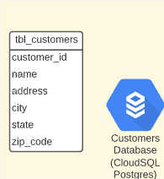
Customer Database explained
Static customer data will be held in a CloudSQL (Postgres) database.
Key Benefits:
Maintain industry standard query languages based on ANSI 1999.
HA and backups provided by the managed service.
Security can be handled by IAM roles instead of maintaining database users directly

Slide 10
Adult Population Dataset
Curate a dataset that provides adult population by state.

Slide 11
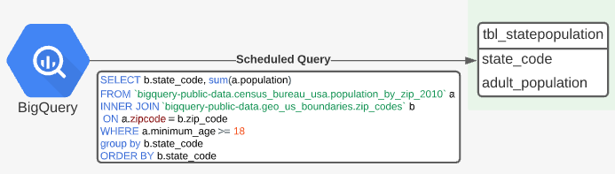
Adult Population Dataset explained
Utilize publicly available BigQuery US Census dataset harvesting state and population
Details:
Low Cost
Utilize a scheduled Query to create a table with the data ready to use.

Slide 12
Create a reporting datamart
End user should be able to query by state several key dimensions to reflect sales effectiveness.
Data must be refreshed at least once a day (more often is better).
Keep the data in the datamart as small as possible to speed performance and reduce cost.

Slide 13
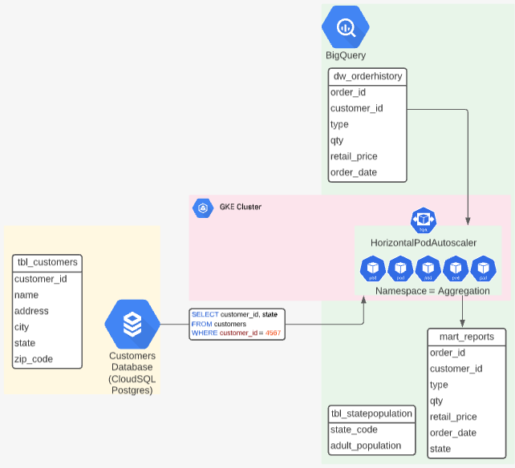
Create a reporting datamart explained
Aggregation microservices consume data from the orderhistory data warehouse and the Customers Database and insert it into the reporting mart.
Details:
Containerized microservices orchestrated by Kubernetes can scale based on the workload utilizing Horizontal Pod Autoscaler.
Create a monthly partition on the mart_reports table and remove month 14+ on a regular basis.
BigQuery can store streaming data very inexpensively ($0.02/GB).
Consider a GCP memorystore between the mart_reports table and the UI if querying BigQuery becomes costly.

Slide 14
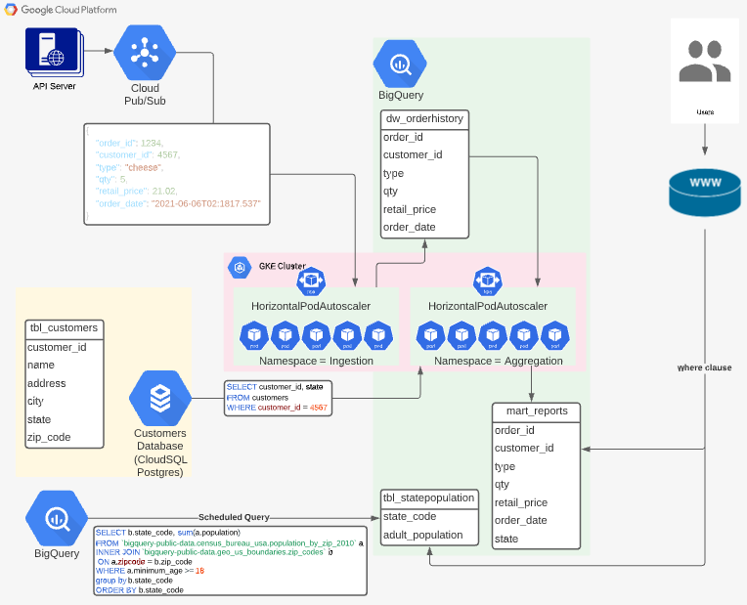
The overall solution
This solution will allow Tarqata to realize their goal of taking over the pizza delivery world. The solutions ability to handle multiple data sets (streaming and static) in a scalable, cloud based microservices solution will aid in future growth.

Slide 15
Planning
How do we pull this off . . . .

Slide 16
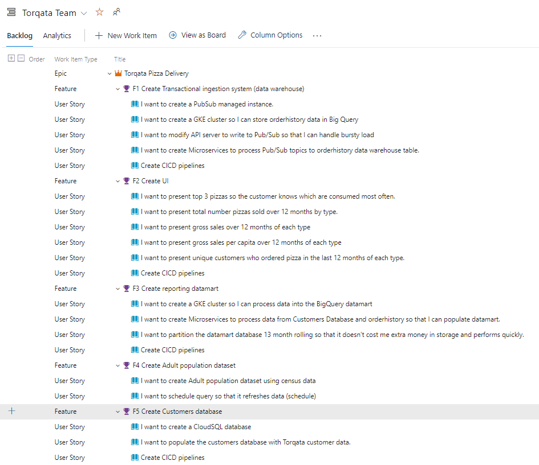
The Backlog (Epics, Features and User Stories)
Feel free to access this list yourself at: https://dev.azure.com/jerrycutshaw

Slide 17
Timeline and execution
To complete this Epic it will require the following personel:
Software Engineer’s (5)
Data Engineer (2)
QA Engineer (1)
Project Manager/SCRUM master (1)
All 5 features could be worked on simultaneously.
Based on estimates the project could be completed in 3 weeks.
Hourly estimate is simply a guess. This is so team/induvial dependent that I had no choice but to SWAG a number. Better numbers should be provided by the Project Managers.

Slide 18
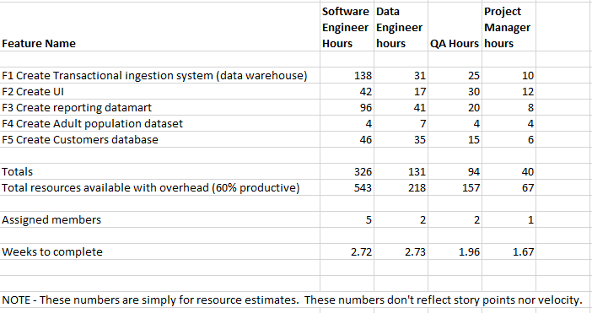
Resource Planning detail

Slide 19
Conclusion

Slide 20
Things to consider if allowed to invest more
Disaster Recovery component to the solution.
Regional replication for DR
Utilize Cloud Dataflow instead of Kubernetes pods. As a serverless technology it could be far less costly.
Proper build out of a true SDLC strategy including Dev, test, uat and prod.
Provide Terraform snippets for building out the infrastructure.
Kubernetes services and deployment YAML snippets.
Fill out ADO project more succinctly with Wiki, more user stories, descriptions, etc.

